Slide 1
B.TECH CSE with Specialization in DevOps
Continuous Integration and Continuous Delivery
Stages of Continuous Integration and Continuous Delivery

Slide 2
Module Objectives
At the end of this module, you will be able to learn about:
Core CI Process
Explain the concept of VCS
Identify merging local changes to the integration branch of VCS tool
Define automated code builds
Explain static code analysis
Discuss automated unit testing
Define code coverage analysis
State automated packaging of the build artifact
Advanced CI process
Give an overview of provision and deploy to test environment
Explain automated functional testing
Learn how to publish report to the development team
Notes:
Notes to the Facilitator:
Explain the module objectives to the participants.
Notes to the Participants:
You will be informed about the module objectives.
At the end of this module, you will be able to:
Core CI Process
Explain the concept of VCS
Identify merging local changes to the integration branch of VCS tool
Define automated code builds
Explain static code analysis
Discuss automated unit testing
Define code coverage analysis
State automated packaging of the build artifact
Advanced CI process
Give an overview of provision and deploy to test environment
Explain automated functional testing
Learn how to publish report to the development team

Slide 3
Module Topics
Let us take a quick look at the topics that we will cover in this module:
Core CI Process
What is VCS ?
Merging Local Changes to the Integration Branch of VCS Tool
How to update fork and create pull request
Code review before merging the code
Automated Code Builds
Automated code builds – Key metrics
Static Code Analysis
Static code analysis – Sample snapshot
Static code analysis – Sample bug report
Static code analysis – OWASP Top 10
Static code analysis – SANS Top 25 sample report

Slide 4
Module Topics (Contd.)
Let us take a quick look at the topics that we will cover in this module:
Automated Unit Testing
Automated Unit Testing - Junit
Unit Testing Frameworks - TestNG
Automated Unit Testing process
Code Coverage Analysis
Code Coverage Methods – Condition Coverage
Code Coverage Methods – Line Coverage
Publishing Code Coverage reports to Jenkins
Automated Packaging of the Build Artifact
Uploading build artifact to a repository

Slide 5
Module Topics (Contd.)
Advanced CI process
Provision and deploy to test environment
Automated Functional Testing
Automated Functional Testing - Example
Publish Report to the Development Team
Google Canary release Case study
Notes:
Notes to the Facilitator:
Inform the participants about the topics that they will be learning in this module.
Notes to the Participants:
You will learn about the following topics in this module:
Core CI Process
VCS Features
Merging Local Changes to the Integration Branch of VCS Tool
How to update fork and create pull request
Code review before merging the code
Automated Code Builds
Automated code builds – Key metrics
Static Code Analysis
Static code analysis – Sample snapshot
Static code analysis – Sample bug report
Static code analysis – OWASP Top 10
Static code analysis – SANS Top 25 sample report
Automated Unit Testing
Automated Unit Testing - Junit
Unit Testing Frameworks - TestNG
Automated Unit Testing process
Code Coverage Analysis
Code Coverage Methods – Condition Coverage
Code Coverage Methods – Line Coverage
Publishing Code Coverage reports to Jenkins
Automated packaging of the build artifact
Uploading build artifact to a repository
Advanced CI process
Provision and deploy to test environment
Automated Functional Testing
Automated Functional Testing - Example
Publish Report to the Development Team
Google Canary release Case study

Slide 6

2.1 What is VCS?
Following are the key features of Version Control System (VCS)
VCS is easy to use.
It provides CLI and GUI interface.
Several developers can collaborate on a single project without losing integrity.
Developers can continuously add, update, change, and delete new source code to VCS.
VCS takes care of the version control issues.
Multiple developers can work on the project without disturbing or waiting for others.
Developer 1
Developer 1
Server
Developer 1
Developer 1
VCS Repository
Notes:
Notes to the Facilitator:
Give a brief to the participants about the VCS features.
Notes to the Participants:
The main feature of the VCS is to record the changes to a file over time. Examples of VCS is CVS, Subversion (Centralized VCS) and Git (Distributed).
Version control systems are useful for developers and designers because they allow you to save and store each distinct version of your files. This allows you to roll back to any of the previous versions when you run into a problem in the current version. Thus, no project is completely lost because of errors, forgetfulness, or a crash.

Slide 7
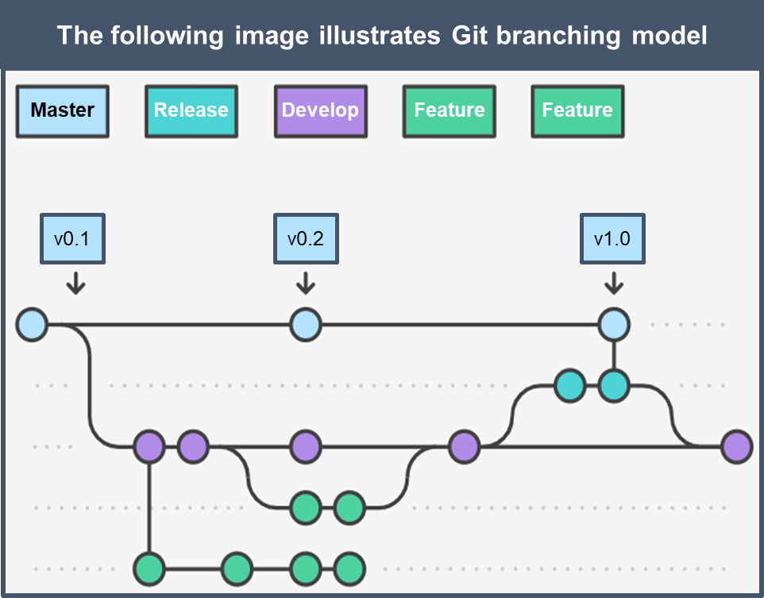
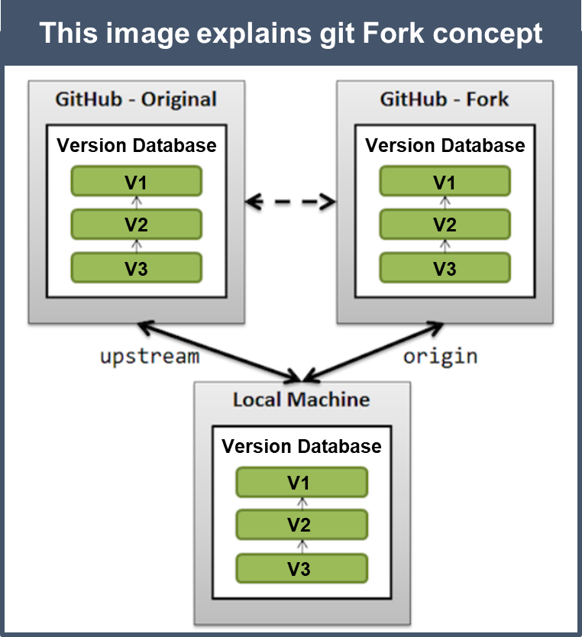
2.1.1 Merging Local Changes to the Integration Branch of VCS Tool
Notes:
Notes to the Facilitator:
Explain the participants about the code merging process.
Notes to the Participants:
Branching in Git: Branches are used to develop new features isolate from each other. When you create a repository master branch is the "default" branch. You need to use other branches for developing new features and merge them back to the master branch upon completion of that feature.
A fork is a copy of the original repository. If you fork a repository all the branches (master, develop, release, feature etc) from main repository will be cloned to your fork copy. Forking the repository allows users to freely experiment their changes without affecting the original project.
Code from Fork can be pushed to original branch using Pull requests.
One good example of using forks is to propose changes for bug fixes. Rather than logging an a bug for the issue found in the original repository:
Fork the repository.
Make the fix in your fork copy.
Submit a pull request to the main repository.
If the project owner agrees with your fix, they might pull your fix into the original repository.
Please note multiple users working on the same project need to update their Fork everyday in order to update their fork with other developer’s changes. It is important to update the Forks before you start your work everyday.

Slide 8
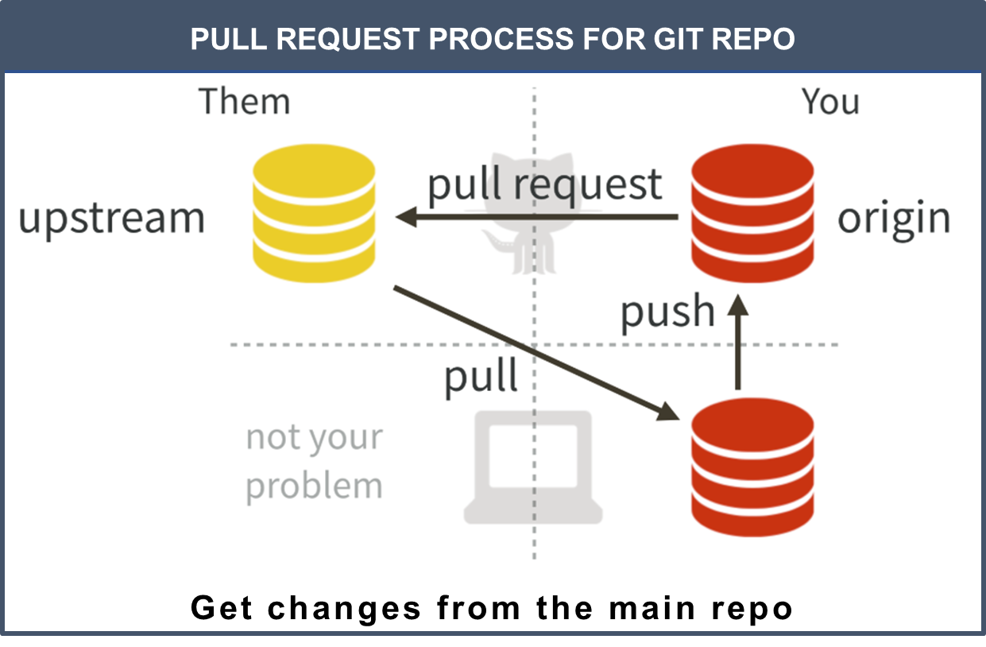
2.1.2 How to Update Fork and Create Pull Request?
Notes:
Notes to the Facilitator:
Explain the participants how to create a pull request from their respective forks.
Notes to the Participants:
Steps to update the Fork:
Open Git hub URL of your project and click on Fork at the top right hand side
Clone forked repository to your local machine. This becomes your origin
git clone –b <branch-name> https://github.com/mgna7/project.git
Set your upstream to main repository (We are considering upes as your organization name in this example)
git remote add upstream https://github.com/upes/project.git
If you git remote –v you can see both the origin and upstream in the log
Everyday you need to run these three commands to update your fork:
git fetch upstream (This command will pull all the latest code from upes git repo)
git merge upstream/<branch-name> (This command will merge your local copy with latest code)
git push (This command will commit the code to your fork)
If there are any code conflicts you need to handle it.
Steps to push your local changes to Fork:
Please make sure your fork is up-to-date with the main repository. Run step5 from the above before starting your work.
Make a change to a file
git add <filename> or .
git commit –m “Committing to fork”
git push
6. Raise a pull request from your fork to main repo to push your changes. After code review it will be merged.

Slide 9
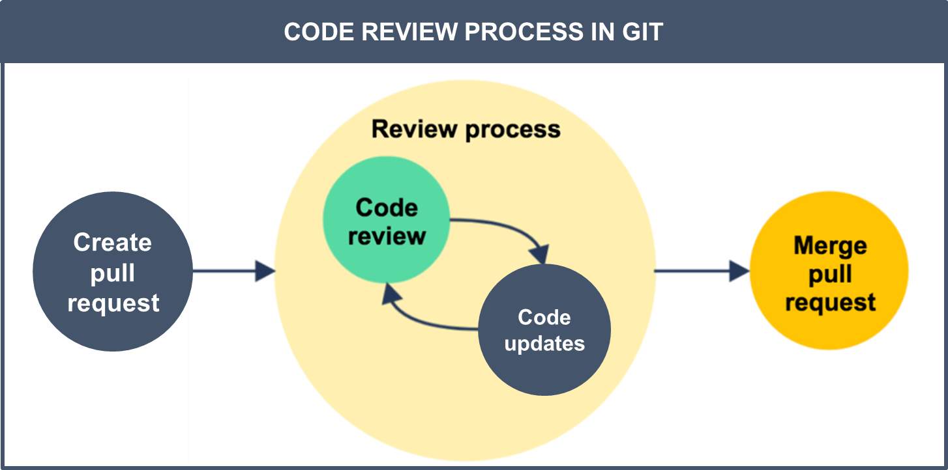
2.1.3 Code Review before Merging the Code
Notes:
Notes to the Facilitator:
Explain the participants about code review and code merge process.
Notes to the Participants:
A code review process framework benefits the organization as follows:
Collaboration between software development team members
Identification and elimination of code defects before integration
Improvement of code quality
Quick turnaround of development cycle
A code review process framework benefits the organization as follows:
Developers update the code on Local machine and push it to fork
git add <filename>
git commit –m “Message”
git push
Fork gets updated with the developers commit
The developer creates a pull request from his fork to the main branch
Generally in big organization once a pull request is submitted, githook will trigger a build only for that Pull request
If the build passes, reviewers will review the code and approve it. Reviewers can send back the pull request if code logic is not correct/any other reasons.
Code is merged to the main branch and integration tests are executed.

Slide 10
What did You Grasp?
1. Which role is required to merge the pull requests?
Pull request creator
Repository member
Collaborator
All of the above
Notes:
Notes to the Facilitator:
Answer:
1. C .Collaborator

Slide 11
What did You Grasp?
2. Pull requests can be build remotely through?
Scripts
Collaborators
Manual intervention
Git hook
Notes:
Notes to the Facilitator:
Answer:
2. D. Git hooks
Through Git hooks a remote build can be triggered for every pull request.

Slide 12
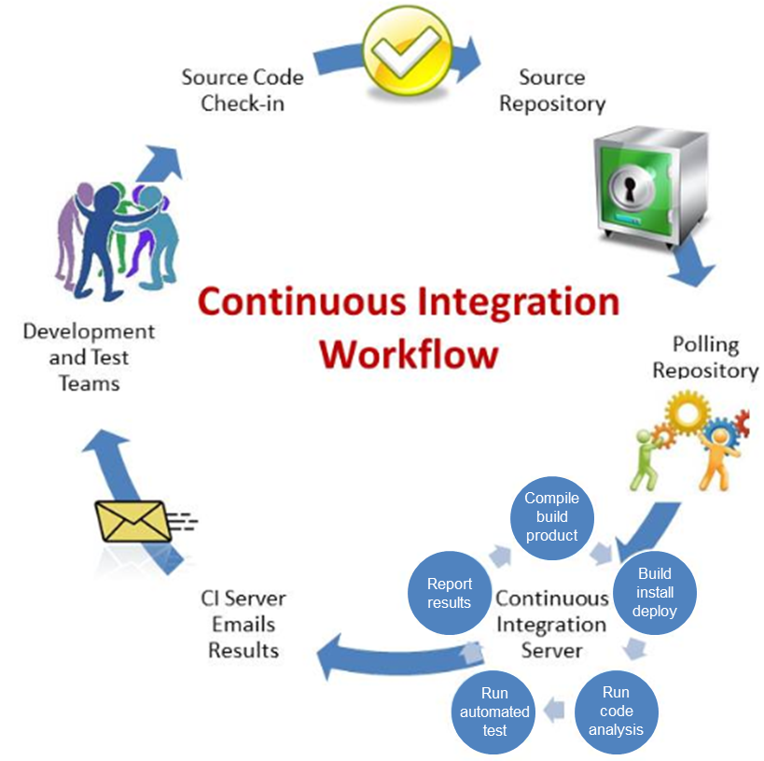
2.2 Automated Code Builds
Automated Code Build Process
Step 1
Write and Commit bits of Code
Step 2
Scan the Code for Problems
Step 3
Compile the Code
Step 4
Run Automated Tests
Step 5
Report Any Problems
Notes:
Notes to the Facilitator:
Give the participants a brief information about automated code builds.
Notes to the Participants:
Automated build is the process of building and deploying the code and the database for a custom application based requirement:
Step 1: Write and Commit bits of Code
Let’s say one of our programmers is busy designing your individualized application on his/her own computer. Red light! What happens if the system crashes? Vast amounts of work may be lost forever. So instead, we commit (or upload) the code to a central source code repository. Imagine this repository as a holding zone, a database for our code.
Step 2: Scan the Code for Problems
With the code in the repository, we then scan it for common problems. There are a variety of tools available for this, based on the programming language used, in our projects JSHint, FxCop and Code Duplication Checkers are some of the most commonly used. We like scanners because they can automatically monitor the code before we deploy it.
Step 3: Compile the Code
We compile the code after we’ve scanned it. In this step we change the programmer’s commands into something that works on your desktop, mobile device or web browser. Here we also use scripts to create the database tables, test data and stored procedures.
Step 4: Run Automated Tests
Finally, we’re ready for the automated tests. For instance, if we’re working with a website application, scripts load the browser automatically, land on a specific page, and test how things work on that page. Typically, there are hundreds of automated tests for a given application. The quality of the application is vastly improved because the automated tests run daily.
Step 5: Report Any Problems
When automated tests detect a problem, our team receives immediate notification in order to swiftly repair it. The result is essentially bug free code throughout the development process. When our manual testers discover new issues, we develop a new automated test expressly for that issue. Selenium is our preferred software testing framework for user interface automated tests.

Slide 13
2.2.1 Automated Code Builds – Key Metrics
List of key metrics considered in the automated builds
Number of features/user stories per build
Average Build time
Percentage of failed builds
Change implementation lead time
Frequency of builds
Notes:
Notes to the Facilitator:
Give the participants a brief about automated code build key metrics.
Notes to the Participants:
Automated build is the process of scripting and automating the retrieval of code from a repository, compiling it, executing automated functional tests, and publishing it to a shared repository.
Below are the list of key metrics considered in automated builds:
Number of features/user stories per build : This indicates a number of new features being implemented/changes implemented and it directly maps to the business value that is created.
Average Build time: This metric indicates the average time required to perform a build.
Percentage of failed builds: This metric impacts the overall team output due to rework.
Change implementation lead time: Affects the number of releases per given period and overall product roadmap planning.
Frequency of builds: This metric indicated the overall output and it tracks the entire activity of the project.

Slide 14
2.3 Static Code Analysis
Static code analysis, also known as "white-box" testing is performed as part of the code review.
Below Techniques are used to calculate the Static Code analysis:
Data Flow Analysis
Control Flow Graph (CFG)
Taint Analysis
Lexical Analysis
Notes:
Notes to the Facilitator:
Explain the participants about the static code analysis and different techniques to analyze code.
Notes to the Participants:
Static code analysis is carried out at the Implementation phase of an SDL (Security Development Lifecycle). Static Code Analysis, commonly refers to the running of Static Code Analysis tools that attempt to highlight possible vulnerabilities within 'static' (non-running) source code by using techniques such as Taint Analysis and Data Flow Analysis.
Data Flow Analysis
● Data flow analysis collects run-time (dynamic) information about data in software code while it is in a static state.
● There are three common terms used in data flow analysis, Control Flow Analysis (the flow of data), basic block (the code), and Control Flow Path (the path the data takes):
○Basic block: A sequence of consecutive instructions where control enters at the beginning of a block, control leaves at the end of a block and the block cannot halt or branch out except at its end.
Example PHP basic block:
○1. $a = 0; 2. $b = 1; 3. 4. if ($a == $b) 5. { # start of block 6. echo “a and b are the same”; 7. } # end of block 8. else 9. { # start of block 10. echo “a and b are different”; 11.} # end of block
○Control Flow Graph (CFG): An abstract graph representation of software by use of nodes that represent basic blocks. A node in a graph represents a block; directed edges are used to represent jumps (paths) from one block to another. If a node only has an exit edge, this is known as an ‘entry’ block, if a node only has an entry edge, this is known as an ‘exit’ block.
Example Control Flow Graph; ‘node 1’ represents the entry block and ‘node 6’ represents the exit block.
Taint Analysis
● Taint Analysis will attempt to identify variables that have been 'tainted' with user controllable input and traces them to possible vulnerable functions also known as a 'sink'. If the tainted variable gets passed to a sink without being sanitized then it is flagged as a vulnerability.
● Some programming languages such as Perl and Ruby have Taint Checking built into them and enabled in certain situations such as accepting data via CGI.
Lexical Analysis
● Lexical Analysis will generally convert the source code syntax into the ‘tokens’ of information to abstract the source code and make it easier to manipulate.
●Pre tokenised PHP source code:
●<?php $name = "Ryan"; ?> Post tokenised PHP source code:
●T_OPEN_TAG T_VARIABLE = T_CONSTANT_ENCAPSED_STRING ; T_CLOSE_TAG
There are many static code analysis tools available. Sonarqube is most widely used tool to do code analysis. Let’s discuss about Sonarqube and its sample reports in coming slides.

Slide 15
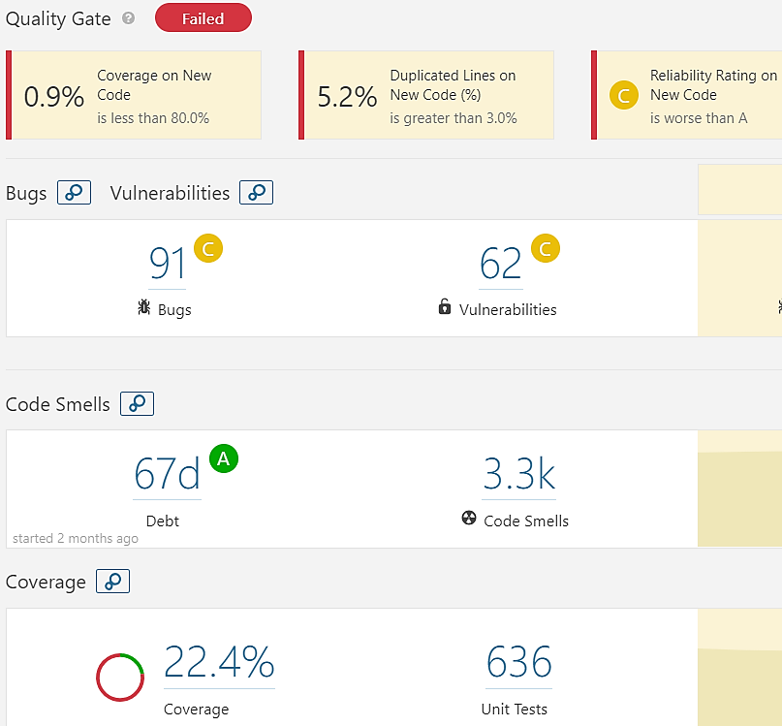
2.3.1 Static Code Analysis – Sample Snapshot
SAMPLE SONARQUBE REPORT
Notes:
Notes to the Facilitator:
Discuss about Static code analysis tool Sonarqube and sample snapshot of static code analysis quality gate report.
Notes to the Participants:
What is Sonarqube?
SonarQube is a free and open source “code quality platform.” It gives moment-in-time snapshot of your code quality today, as well as trending of lagging (what’s already gone wrong) and leading (what’s likely to go wrong in the future) quality indicators. For test coverage (a leading indicator), a score of 50% may not look great.
SonarQube doesn’t just show you what’s wrong. It also offers quality-management tools to actively help you put it right: IDE integration, integration for Jenkins, a popular Continuous Integration server, and code-review tools.
SonarQube is written in Java, and it started as a way to measure the quality of Java projects, but it’s no longer limited to analyzing just Java. There is an ever-growing list of languages you can analyze through SonarQube by adding plugins, many of which are provided by the SonarQube community and offered for free.
The above report is created using Sonarqube. In Sonarqube a quality gate is the best way to enforce a quality policy in your organization. It can answer ONE important question: can we deliver the project to production today or not?
In order to answer this question, you can define a set of Boolean conditions based on measure thresholds against which projects are measured. For example:
No new blocker issues
Code coverage on new code greater than 80%
Etc.

Slide 16
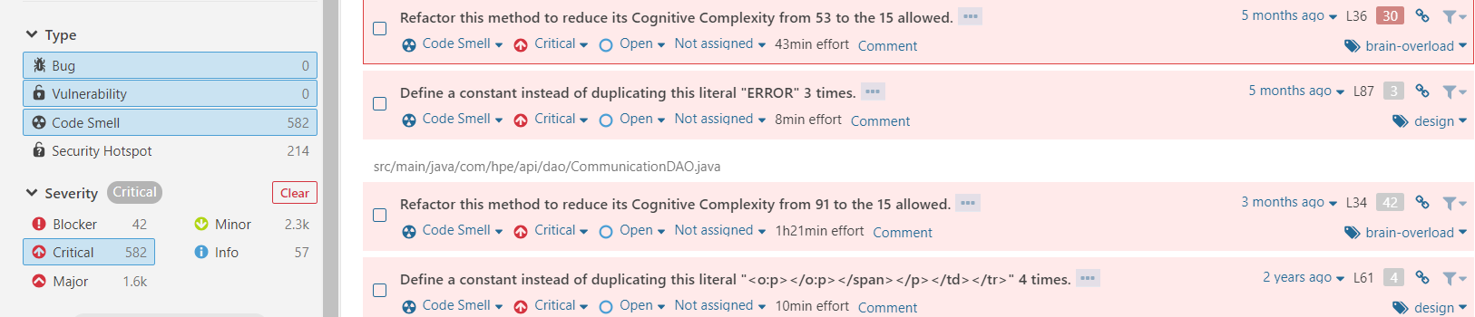
2.3.2 Static Code Analysis – Sample Bugs Report
BUGS AND VULNERABILITIES IN SONARQUBE REPORT
Notes:
Notes to the Facilitator:
Give a brief about the critical issues that is present in the screenshot.
Notes to the Participants:
The above screenshot highlights the critical bugs in Sonarqube report. Sonarqube gives recommendation to fix the coding issues.
In SonarQube, rules are executed in source code to generate issues. There are four types of rules:
Code Smell (Maintainability domain)
Bug (Reliability domain)
Vulnerability (Security domain)
Security Hotspot (Security domain)
Security rating is assigned with below alphabets in the report:
A = 0 Vulnerabilities B = at least 1 Minor Vulnerability C = at least 1 Major Vulnerability D = at least 1 Critical Vulnerability E = at least 1 Blocker Vulnerability

Slide 17
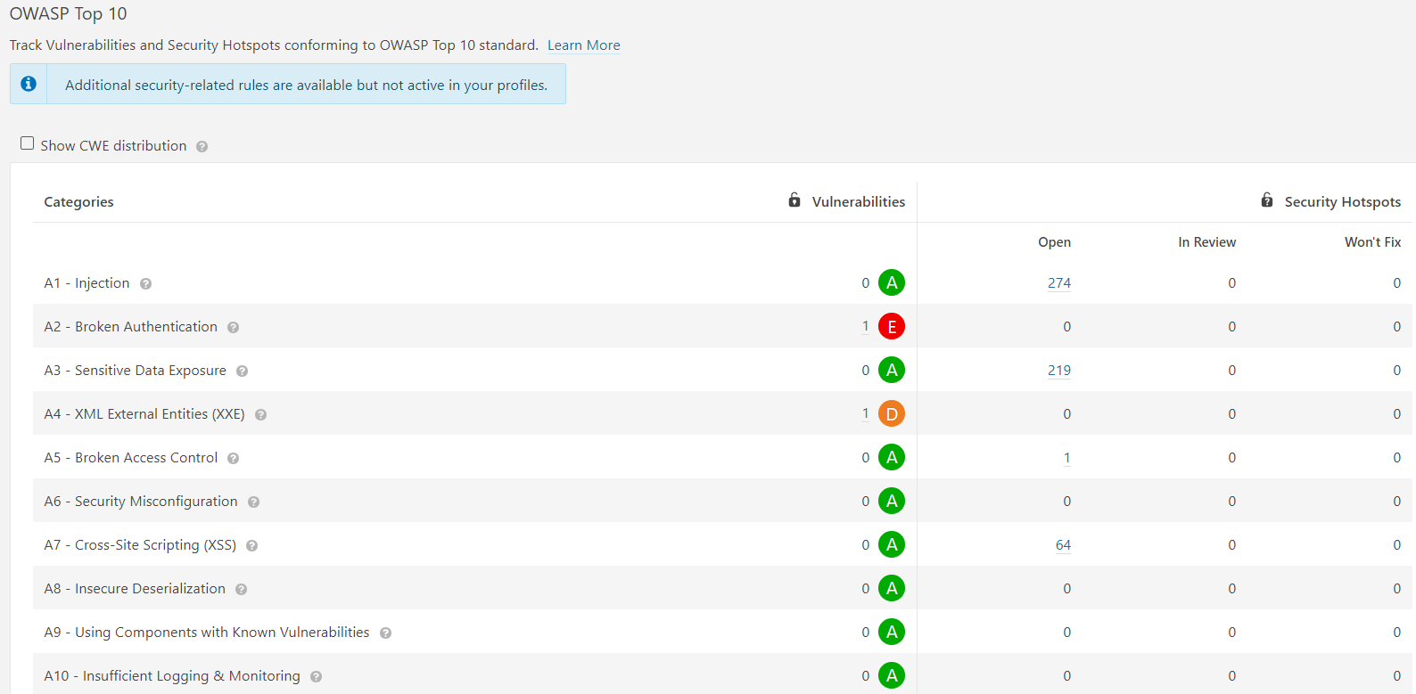
2.3.3 Static code Analysis – OWASP Top 10 Sample Report
SAMPLE OWASP REPORT OF SONARQUBE
Notes:
Notes to the Facilitator:
Explain the participants about the static code analysis – OWASP Top 10 report.
Notes to the Participants:
The following is the list of OWASP Top 10 Security Risks, and offers best practices and solutions to prevent or remediate them.
1. Injection
Injection flaws, such as LDAP injection, SQL injection, and CRLF injection, occur when an attacker starts sending untrusted data to an interpreter that is executed as a command without proper authorization.
Solution: * Application security testing can easily detect injection flaws. Developers must use parameterized queries in the code prevent injection flaws.
2. Broken Authentication and Session Management
Incorrectly configured session and user authentication can allow attackers to compromise the passwords, session tokens or keys, or get all the details of users’ accounts to assume their identities.
Solution: * Multi-factor authentication (FIDO) or dedicated apps, can reduce the risk of compromised accounts.
3. Sensitive Data Exposure
APIs and Applications that don’t properly protect sensitive data such as usernames and passwords, financial data, or health information, could allow attackers to access sensitive information to steal identities or commit fraud.
Solution: * Encryption of data at rest and in transit can help you comply with data protection regulations.
4. XML External Entity
Poorly configured XML processors expose external entity references within XML documents. There is a change of using external entities by attackers to execute the code remotely, and to disclose SMB file shares and internal files.
Solution: * Static application security testing (SAST) can discover this issue by inspecting configuration and dependencies.
5. Broken Access Control
Improperly configured or missing restrictions on authenticated users allow them to access unauthorized functionality or data, such as viewing sensitive documents, accessing other users’ accounts, and modifying access and data rights.
Solution: * Penetration testing can detect non-functional access controls; whereas other testing methods can only detect where access controls are missing.
6. Security Misconfiguration
This risk refers to improper implementation of controls that is intended to keep application data safe, such as information leakage, misconfiguration of security headers, and not patching or upgrading systems, components, and frameworks.
Solution: * Dynamic application security testing (DAST) can detect misconfigurations, such as leaky APIs.
7. Cross-Site Scripting
Cross-site scripting (XSS) is a flaw that can enable an attacker to inject client-side scripts into the application, for example, to redirect users to malicious websites.
Solution: * Developer training complements security testing to help programmers prevent cross-site scripting with best coding best practices, such as input validation and encoding data.
8. Insecure deserialization
Insecure deserialization flaw can enable an attacker to execute attacker’s code in the application remotely, delete serialized or tamper objects, conduct injection attacks, and elevate privileges.
Solution: * Application security tools can detect deserialization flaws, but penetration testing is required frequently to validate the problem.
9. Using Components With Known Vulnerabilities
Developers frequently can not find which open source and third-party components are in their applications, making it difficult to update components when new vulnerabilities when they are discovered. Attackers can exploit an insecure component to steal sensitive data or take over the server.
Solution: * Software composition analysis with static analysis can identify insecure versions of components.
10. Insufficient Logging and Monitoring
The time to detect a breach is frequently measured in weeks or months. ineffective integration and Insufficient logging and with security incident response systems allow attackers to pivot to other systems and maintain persistent threats.
Solution: * Think like an attacker and use pen testing to find out if you are using efficient security monitoring; examine your logs after pen testing.

Slide 18
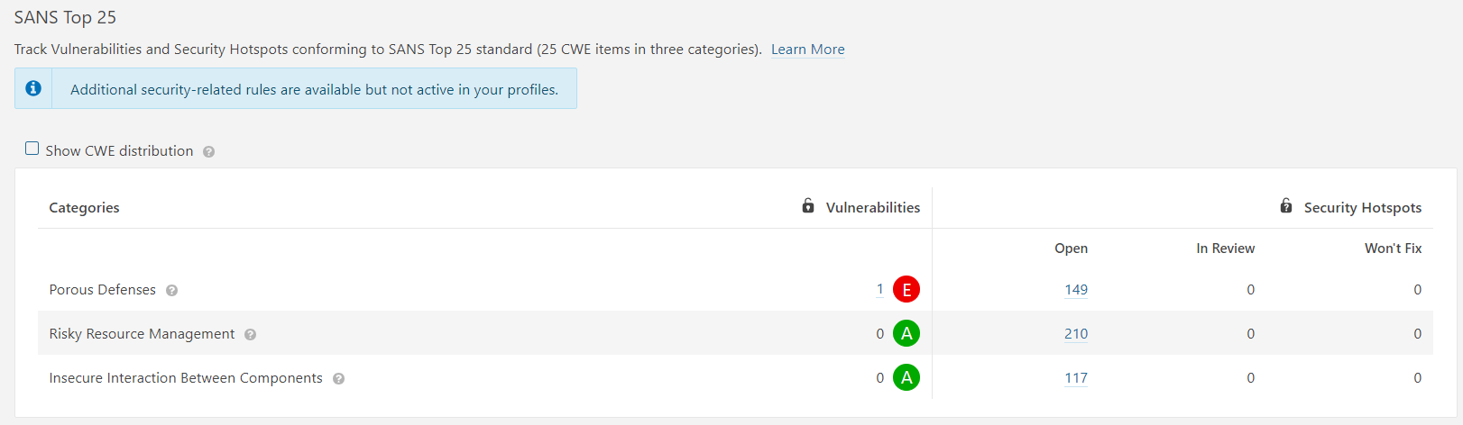
2.3.4 Static Code Analysis – SANS Top 25 Sample Report
SAMPLE SANS TOP 25 REPORT OF SONARQUBE
Notes:
Notes to the Facilitator:
Explain the participants about the Static code analysis – SANS Top 10 report.
Notes to the Participants:
SANS TOP 25 highlights the most Dangerous Top 25 Software Errors
Insecure Interaction Between Components:
CWE ID Name
CWE-89 Improper Neutralization of Special Elements used in an SQL Command ('SQL Injection')
CWE-78 Improper Neutralization of Special Elements used in an OS Command ('OS Command Injection')
CWE-79 Improper Neutralization of Input During Web Page Generation ('Cross-site Scripting')
CWE-434 Unrestricted Upload of File with Dangerous Type
CWE-352 Cross-Site Request Forgery (CSRF)
CWE-601 URL Redirection to Untrusted Site ('Open Redirect')
Risky Resource Management:
The weaknesses in this category are related to ways in which software does not properly manage the creation, usage, transfer, or destruction of important system resources.
CWE ID Name
CWE-120 Buffer Copy without Checking Size of Input ('Classic Buffer Overflow')
CWE-22 Improper Limitation of a Pathname to a Restricted Directory ('Path Traversal')
CWE-494 Download of Code Without Integrity Check
CWE-829 Inclusion of Functionality from Untrusted Control Sphere
CWE-676 Use of Potentially Dangerous Function
CWE-131 Incorrect Calculation of Buffer Size
CWE-134 Uncontrolled Format String
CWE-190 Integer Overflow or Wraparound
Porous Defenses:
The weaknesses in this category are related to defensive techniques that are often misused, abused, or just plain ignored.
CWE ID Name
CWE-306 Missing Authentication for Critical Function
CWE-862 Missing Authorization
CWE-798 Use of Hard-coded Credentials
CWE-311 Missing Encryption of Sensitive Data
CWE-807 Reliance on Untrusted Inputs in a Security Decision
CWE-250 Execution with Unnecessary Privileges
CWE-863 Incorrect Authorization
CWE-732 Incorrect Permission Assignment for Critical Resource
CWE-327 Use of a Broken or Risky Cryptographic Algorithm
CWE-307 Improper Restriction of Excessive Authentication Attempts
CWE-759 Use of a One-Way Hash without a Salt

Slide 19
What did You Grasp?
1. Which of the following is the key metrics of automated build process?
Number of lines of code per build
Number of test cases
Frequency of failed builds
Size of the build log
Notes:
Notes to the Facilitator:
Answer: 3. Frequency of failed builds.
If the build failure ratio is high, then the quality of code is not up to the mark.

Slide 20
What did You Grasp?
2. How to enforce quality policy in Sonarqube?
Through a template
Through quality gates
By using third party plugins
Not configurable
Notes:
Notes to the Facilitator:
Answer: 2. Through quality gates
Quality gates are the best way to enforce quality profiles in Sonarqube. There are some Plugins which can fail the build based on Quality gates score.

Slide 21
2.4 Automated Unit Testing
Unit tests can be automated requires
A good strategy that defines the test types and amount of testing.
A test plan that indicates the tasks to be done to implement the test strategy.
Test data definition, that includes both existing “production like” data and input data, used when executing the test.
Test environment where the application is deployed, and where testing cycles are carried out.
Testing framework is required to automate Unit tests.
Notes:
Notes to the Facilitator:
Give a brief about continuous delivery.
Notes to the Participants:
Many organizations create test cases in excel sheet and few in word documents. Some organizations use HP ALM to document the test cases.
Every test case have similar attributes:
Title
Description
Priority
Assumptions and/or pre-conditions
A set of test steps
Test data to be used to test the functionality
Expected result
Notes etc

Slide 22
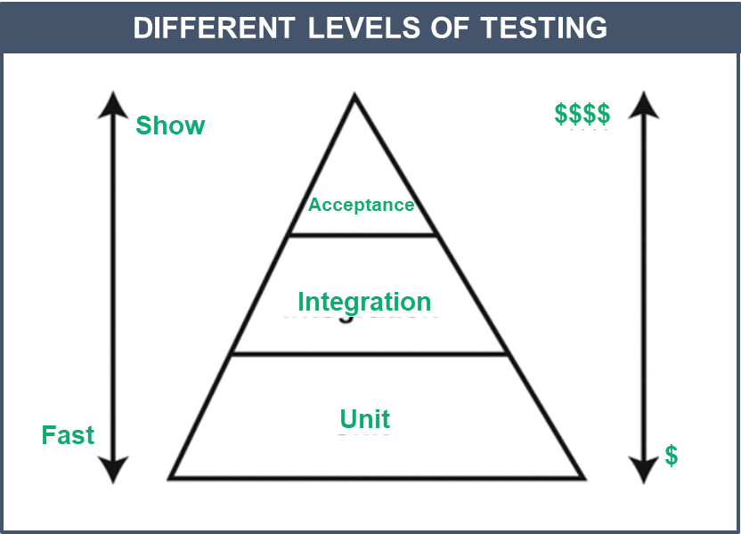
2.4.1 Unit Testing
Notes:
Notes to the Facilitator:
Discuss about Unit tests and its benefits in detail.
Notes to the Participants:
Levels of Testing:
As you start practicing TDD (Test Driven Development), you will write different levels of tests. Your application should be composed of tests in each of the following levels. Each of these levels focuses on a different aspect of code and provides different feedback. Let’s look at them one by one.
Unit testing: Here you test individual software components to verify if the individual unit does the right thing in isolation.
Integration testing: Here you test multiple units together to verify if they work correctly as a unit.
Acceptance testing: Here you test the full system to verify if it works as per user expectations. It is often referred to as functional testing.
Benefits of Unit Testing:
unit testing is no longer a post-development exercise. It is as equally important as writing production code and must be done up front. Benefits are Unit testing are:
Determines specifications
Provides early error detection
Supports Maintenance
Improves Design
Better product documentation
To run Unit tests when building the code we need a Framework (Example: Junit). Junit framework will execute all the Unit tests one by one while executing your code.
To run Junit tests the first step it to add dependency information in the pom.xml
<dependency> <groupId>junit</groupId> <artifactId>junit</artifactId> <version>4.12</version> <scope>test</scope> </dependency>
Let’s look at the below class and Junit test:
Below class will concatenate both the strings:
public class MyJUnit {
public String concatenate(String one, String two
)
{
return one + two;
}
}
2. Junit testcase for this class:
import org.junit.Test;
import static org.junit.Assert.*;
public class MyJUnitTest {
@Test
public void testConcatenate() {
MyJUnit myJUnit = new MyJUnit();
String result = myjUnit.concatenate("one", "two");
assertEquals("onetwo", result);
}
}
This is considered as positive testcase. In Negative testcase we can test assertNotEquals(“twoone”,result)
The above unit test is an ordinary class, with one method - testConcatenate(). This method is annotated with the @Test annotation. This will signal the unit test runner, that this is a unit test, that should be executed. If methods are not annotated with @Test will not be executed by the test runner.

Slide 23
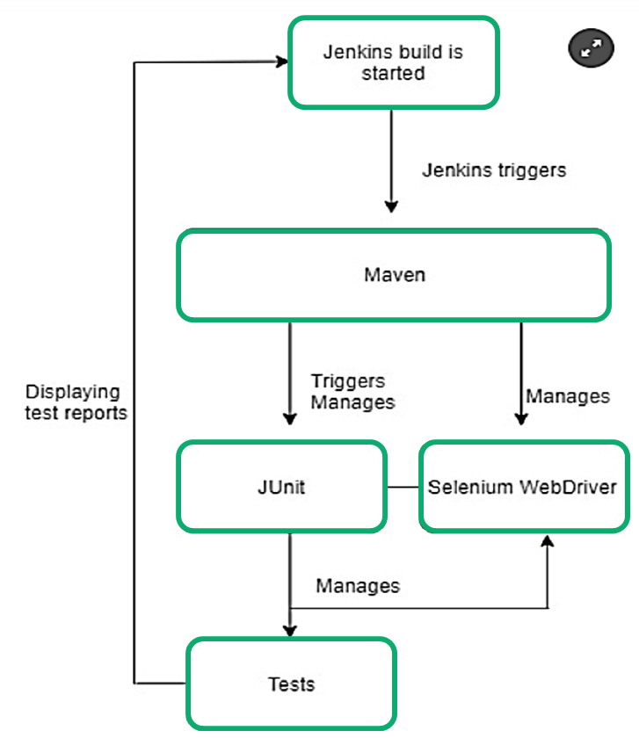
2.4.3 Automated Unit Testing
Automated Unit Testing Process Through Jenkins Tool
Notes:
Notes to the Facilitator:
Give a brief about automated unit testing.
Notes to the Participants:
Refer the above picture. Logical flow of Automated unit testing through Jenkins is shown.
Automated Unit tests are executed in the following flow:
New code is checked-in to SCM (Example - Git)
Git hooks send message to build tool (Example - Jenkins)
Jenkins will execute the build and run Unit tests through a framework (Junit/TestNG)
If all the tests are passed, build is passed on to next stage and reports are deployed to the dashboard
If any Unit test fails build will fail and developers will be notified through standard communication channels

Slide 24
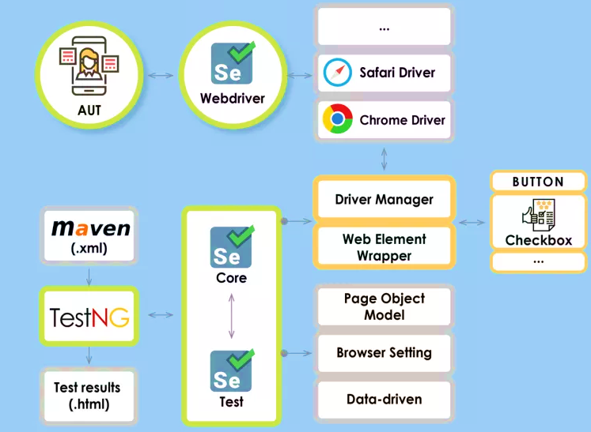
2.4.2 Functional test example using - TestNG
FUNCTIONAL TEST USING TESTNG FRAMEWORK
Notes:
Notes to the Facilitator:
Give a brief about sample functional test example using TestNG framework.
Notes to the Participants:
Above picture represents a sample functional test using TestNG framework. Let us see more details about TestNG framework:
TestNG is most popularly used with Selenium for UI testing.
TestNG is similar to Junit testing framework, but it is more powerful than Junit, especially in testing integrated classes. TestNG inherits all of the benefits that JUnit is offering.
TestNG eliminates most of the limitations of the older framework and gives developers the ability to write more flexible and powerful tests. Some of the highlight features are: easy annotations, grouping, sequencing and parameterizing.
TestNG eliminates most of the limitations present in the old framework, it allows developers to write more powerful and flexible test cases with the help of easy annotations, sequencing, grouping and parameterizing.
In the above screenshot we are testing an application login feature using Firefox browser.
Let’s discuss about the methods used in the below test case:
@BeforeMethod : Launch Firefox browser and open the Base URL
@Test : Enter Username & Password to Login, Print console message and Log out
@AfterMethod : Close Firefox browser
package automationFramework;
import java.util.concurrent.TimeUnit;
import org.openqa.selenium.By;
import org.openqa.selenium.WebDriver;
import org.openqa.selenium.firefox.FirefoxDriver;
import org.testng.annotations.Test;
import org.testng.annotations.BeforeMethod;
import org.testng.annotations.AfterMethod;
public class TestNG {
public WebDriver driver;
@Test
public void main() {
// Find the element that's ID attribute is 'account'(My Account)
driver.findElement(By.id("account")).click();
// Find the element that's ID attribute is 'log' (Username)
// Enter Username on the element found by above desc.
driver.findElement(By.id("log")).sendKeys("testuser_1");
// Find the element that's ID attribute is 'pwd' (Password)
// Enter Password on the element found by the above desc.
driver.findElement(By.id("pwd")).sendKeys("Test@123");
// Now submit the form. WebDriver will find the form for us from the element
driver.findElement(By.id("login")).click();
// Print a Log In message to the screen
System.out.println(" Login Successfully, now it is the time to Log Off buddy.");
// Find the element that's ID attribute is 'account_logout' (Log Out)
driver.findElement(By.id("account_logout"));
}
@BeforeMethod
public void beforeMethod() {
// Create a new instance of the Firefox driver
driver = new FirefoxDriver();
//Put a Implicit wait, this means that any search for elements on the page could take the time the implicit wait is set for before throwing exception
driver.manage().timeouts().implicitlyWait(10, TimeUnit.SECONDS);
//Launch the Online Store Website
driver.get("http://www.onlinestore.toolsqa.com");
}
@AfterMethod
public void afterMethod() {
// Close the driver
driver.quit();
}
}

Slide 25
2.5 Code Coverage Analysis
The following are the key details of code coverage analysis
The process of discovering the code that is not exercised by the tests.
This information will be used to improve the test suite by adding test cases or modifying the existing ones to increase coverage.
Code Coverage Analysis can find the quality of your unit testing.
It enables developers to quickly and easily improve the quality of their unit tests.
An application with higher code coverage has chances of lower bugs.
Generally code coverage is one of the exit criteria for each milestone.
Notes:
Notes to the Facilitator:
Give a brief about code coverage analysis.
Notes to the Participants:
Code coverage is a mechanism to find how many lines/arcs/blocks/ of your code is executed while running the automated tests. Code coverage is collected by specialized tools by adding tracing calls and run a full set of automated tests against the product. A good code coverage tool will not only give the percentage of the code that is covered, but also will show which lines of code were covered during a particular test.
There are multiple code coverage types. We will now discuss some sample report of condition and line coverage in the next slide.

Slide 26
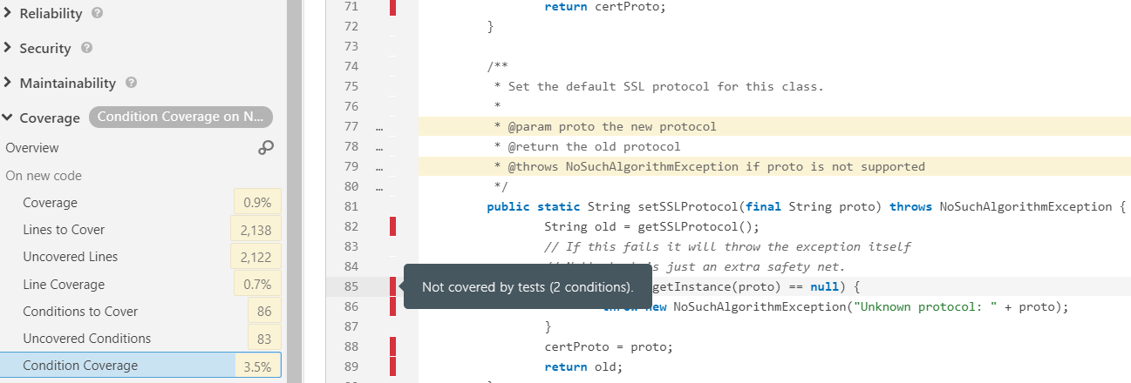
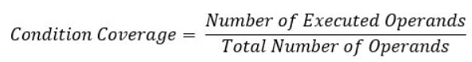
2.5.1 Code Coverage Methods – Condition Coverage
SAMPLE CONDITIONAL COVERAGE REPORT FROM THE SONARQUBE
Notes:
Notes to the Facilitator:
Explain the participants about the condition coverage in code coverage methods.
Notes to the Participants:
The above screenshot shows sample Condition coverage report from the Sonarqube. The conditions which are not covered by the tests are highlighted as shown in the above picture
Conditional coverage will reveal how the subexpressions or variables in the conditional statement are evaluated. In this type of coverage, expressions with only logical operands are considered. For example, if an expression has Boolean operations like OR, AND, XOR, which are total possibilities. Condition coverage does not give a guarantee about full decision coverage.

Slide 27
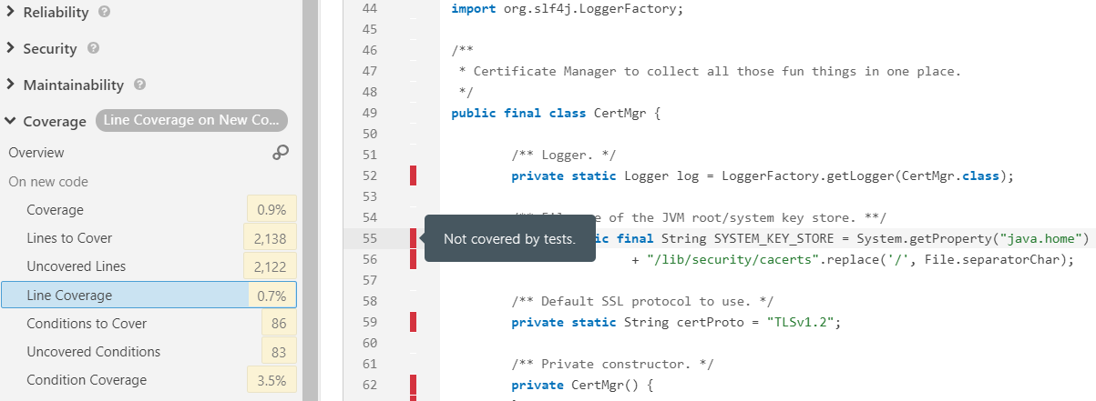
2.5.2 Code Coverage Methods – Line Coverage
LINE COVERAGE REPORT FROM THE SONARQUBE
Notes:
Notes to the Facilitator:
Explain the participants about the line coverage in code coverage methods.
Notes to the Participants:
The above screenshot shows sample Line coverage report from the Sonarqube. The lines which are not covered by the tests are highlighted as shown in the above picture
Line coverage is also known as statement coverage. The formula used to calculate statement coverage is:
Statement Coverage=(Number of statements exercised/Total number of statements)*100
Studies have shown that black-box testing can actually achieve only 60% to 75% statement coverage, but still this leaves around 25% to 40% of the statements untested.
To illustrate the principles of code coverage lets take an which is not specific to any programming language. We have numbered the code lines just to illustrate the statement coverage example, however this may not always be correct.
READ A
READ A
IF A>B
PRINT “A is greater than B”
ENDIF
Let us see how can we achieve 100% code coverage for this example code, we can have 100% coverage by just one test set in which variable A is always greater than variable B.
TEST SET 1: A=10, B=5
A statement may be spread over several lines or in a single line. A statement can contain more than one statement. Some code coverage tools execute statements together in a block and consider them as a single statement.

Slide 28
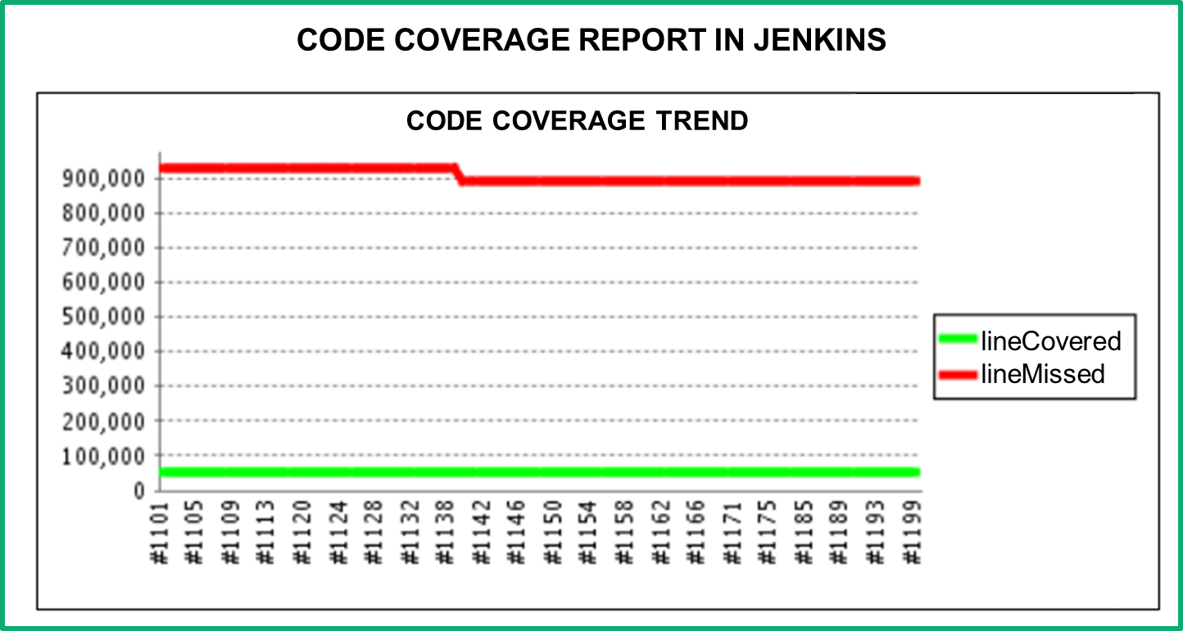
2.5.3 Publishing Code Coverage Reports to Jenkins
Notes:
Notes to the Facilitator:
Explain the participants how to publish code coverage report in Jenkins.
Notes to the Participants:
The picture in above slide shows the Code coverage report in Jenkins.
To enable code coverage in Jenkins:
Go to Post build actions section.
Select the Record Emma Coverage report.
In the text box enter pattern like **/coverage.xml.
If you leave it blank, Jenkins will search the entire workspace for Coverage.xml generated during the build.
Jenkins will publish the coverage report as shown in the above picture.

Slide 29
What did You Grasp?
1. Fill in the blank.
In code coverage analysis, conditional coverage can be calculated using……………….:
Number of execute operands/Total number of operands
Number of conditions checked/Total number of conditions
Number of lines covered/Total number of conditions
Number for lines not covered/Total number of conditions
Notes:
Notes to the Facilitator:
Answer: 1. Number of execute operands/Total number of operands
Conditional coverage can be calculated using the above predefined formula by any code analysis tools.

Slide 30
What did You Grasp?
2. State whether below statement is True or False:
Unit tests can be executed to calculate code coverage.
True
False
Notes:
Notes to the Facilitator:
Answer: 1. True
Unit tests are executed by code coverage tools through plugins like Jaccoco, emma to calculate the code coverage of the project.

Slide 31
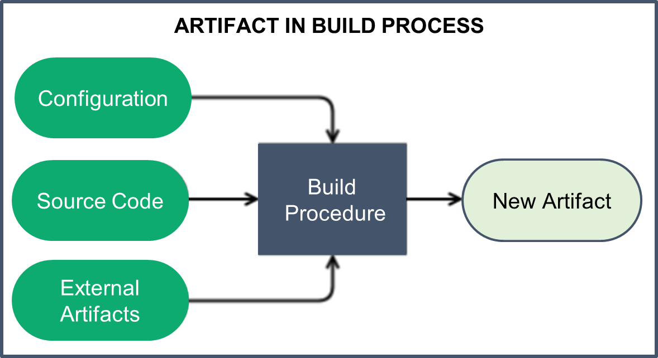
2.6 Automated Packaging of the Build Artifact
Notes:
Notes to the Facilitator:
Explain the participants about the automated packaging of the build artifact.
Notes to the Participants:
Artifact is automatically generated as part of a build process. Artifacts could be:
The source code
The compiled application
A deployable package
Documentation
Examples are jar, war, tar, etc.
The output of a build job is persisted into an artifact and it can be used later to run your application. The build process automatically packages the artifact as per your project configuration.
Example 1: In a Java project you can package all your class files and dependencies into .jar file which is called an artifact.
Example 2: A build artifact file generated by your project, for example .apk which can be uploaded to Googleplay.
As per naming convention of Maven a build artifact can be identified using:
groupID: It is a unique identifier for your project
artifactID: It is the actual name of your artifact with out version
version: For distribution purpose you can choose a version for your artifact

Slide 32
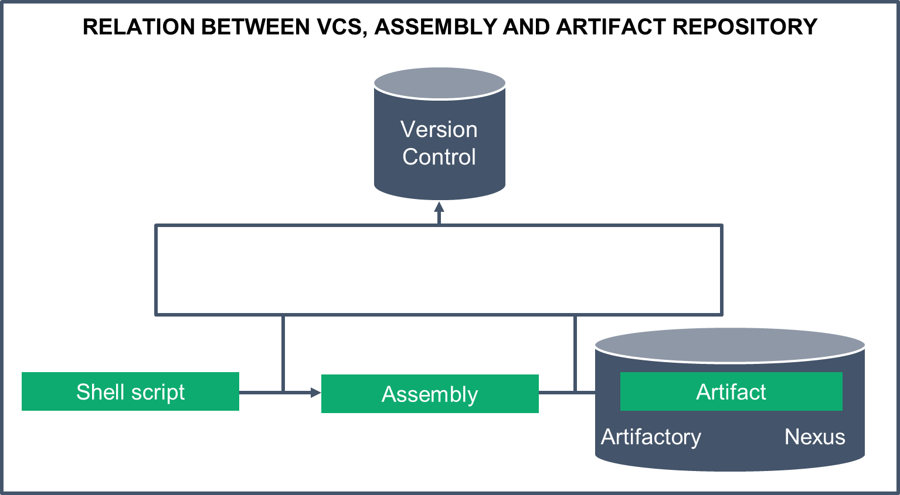
2.6.1 Uploading Build Artifact to a Repository
Notes:
Notes to the Facilitator:
Explain the process of uploading the artifact to a repository.
Notes to the Participants:
The above picture displays the relation between VCS, assembly and artifact repository.
Build tools automatically generate the artifact and it can be shared across teams.
Most of the organizations publish their artifacts to a repository like artifactory, nexus, etc either through a build process or a script.
In maven you need to configure the artifact type (Jar,war,zip etc), repository server configuration in your pom.xml and run mvn deploy command to deploy your artifacts to a Repository
In Gradle you need to define what to publish and where to publish in your configuration file and run gradle publish to deploy the artifacts to a repository.

Slide 33
What did You Grasp?
1. Fill in the blank.
Artifact attributes can be specified in………………..
Global settings.xml
Pom.xml
Build tool
External script
Notes:
Notes to the Facilitator:
Answer:
1. B. Pom.xml
Maven artifact attributes - GroupID, ArtifactID, Version, Classifier and Type should be specified in pom.xml.

Slide 34
What did You Grasp?
2. Which one of the following is not an artifact?
Jar
War
Tar
iso
Notes:
Notes to the Facilitator:
Answer:
2. D. iso

Slide 35
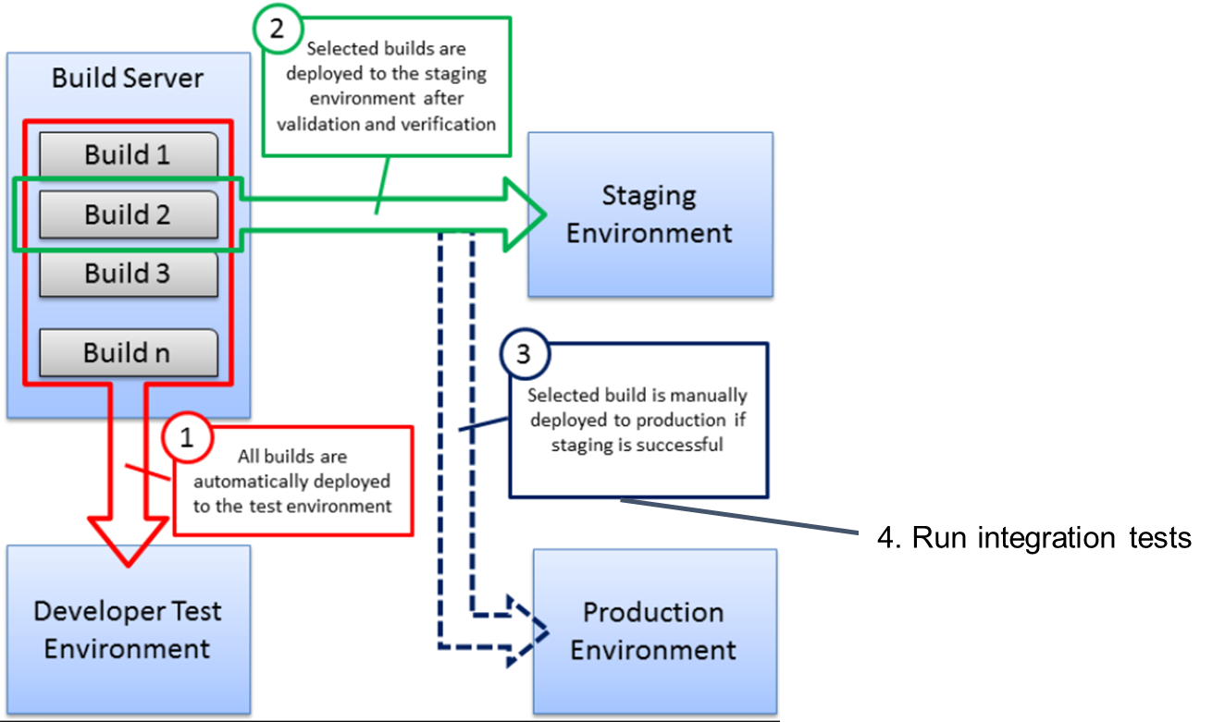
2.7 Provision and Deploy to Test Environment
PICTORIAL REPRESENTATION OF THE ENTIRE BUILD PROCESS
Notes:
Notes to the Facilitator:
Give the participants an overview of the provisioning and deployment to test environment
Notes to the Participants:
The above image shows a pictorial representation of the entire build process.
By default, all the builds are deployed to the testing environment.
Developer check-in the code to an SCM
SCM will trigger a remote build through git hooks or polling
Build tool will build the application and deploy it to test environment
Various integration tests are executed in the test environment.

Slide 36
2.7.1 Deploying application to test environment
Build Server (Dev)
Major Parts Constituting a Deployment Pipeline
Deployment
Testing Environment
Notes:
Notes to the Facilitator:
Give the participants an overview of the continuous deployment process.
Notes to the Participants:
In test environment the build is subjected to multiple test suites.
The build is tested with various parameters.
It is the duty of these test suites to catch the bugs.
Testing result decides whether to release the application to production or not based on number of bugs.
Deploying the application to staging involves these steps:
Deploying the application
Testing the deployment
Activating the release for all users

Slide 37
2.8 Automated Functional Testing
Following are the key details of functional tests
Functional testing is an automated testing that tests how applications function with the rest of the system.
Traditionally, functional testing is implemented by a team of testers, independent of the developers.
Functional testing will be done based on the requirements and business scenarios.
Functional testing will ensure that new bug fixes did not break existing functionality.
Functional testing plan include – testing purpose, test construction, test automation, execution and checking the results.
Notes:
Notes to the Facilitator:
Give the participants an overview of functional tests.
Notes to the Participants:
Functional testing has many categories and these can be used based on the scenario.
Unit testing
Sanity testing
Smoke testing
Regression tests
Integration tests
Beta/Usability testing
There are various steps involved in functional testing:
Determine the functionality of the product that is to be tested
Created input data for the functionality as per the requirement specification
Executed the test cases that are prepared
Review the output to find whether the functionality is as per the expectation or not

Slide 38
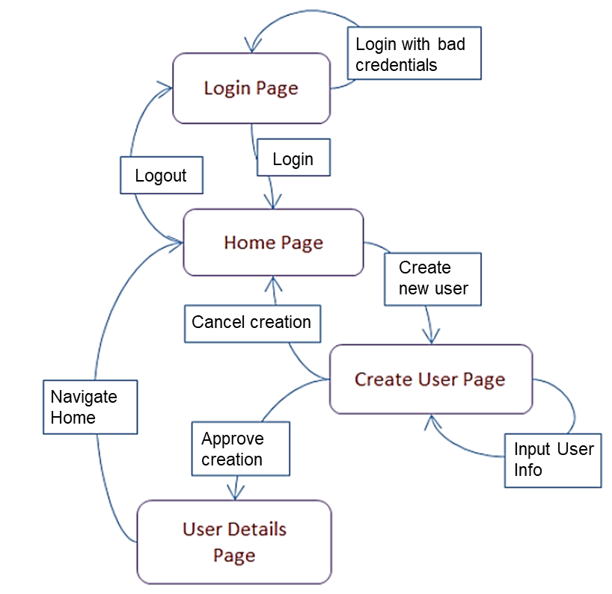
2.8.1 Automated Functional Testing - Example
FUNCTIONAL TEST EXAMPLE OF LOGIN AND USER REGISTRATION PAGE
Notes:
Notes to the Facilitator:
Give the participants an overview of the example functional testing in the above screenshot.
Notes to the Participants:
For example take an online learning portal which is shown above where the student registers/logs in with his user account and password. On the home page, there are two pages Create user and Login page. If a user creates his account it should be approved by the admin. If user has already registered he can enter a username and password, and two buttons: Login and Cancel. Successful login takes the user to the learning portal home page and cancel will cancel the login.
Specifications are as shown below:
#1 ) The user id field accepts a minimum of 7 characters, a maximum of 12 characters, letters(a-z, A-z), numbers(0-9), special characters (only underscore, hyphen allowed) and it cannot be left blank. User id must begin with a character or a number and special characters are not allowed.
#2) Password field accepts a minimum of 8 characters, a maximum of 12 characters, letters (a-z, A-Z), numbers (0-9), special characters (all) and cannot be blank.
Based on these specifications, functional tests can be executed and check if the portal is working as per the specifications. If users try to login using bad credentials, it is an example of negative testing.

Slide 39
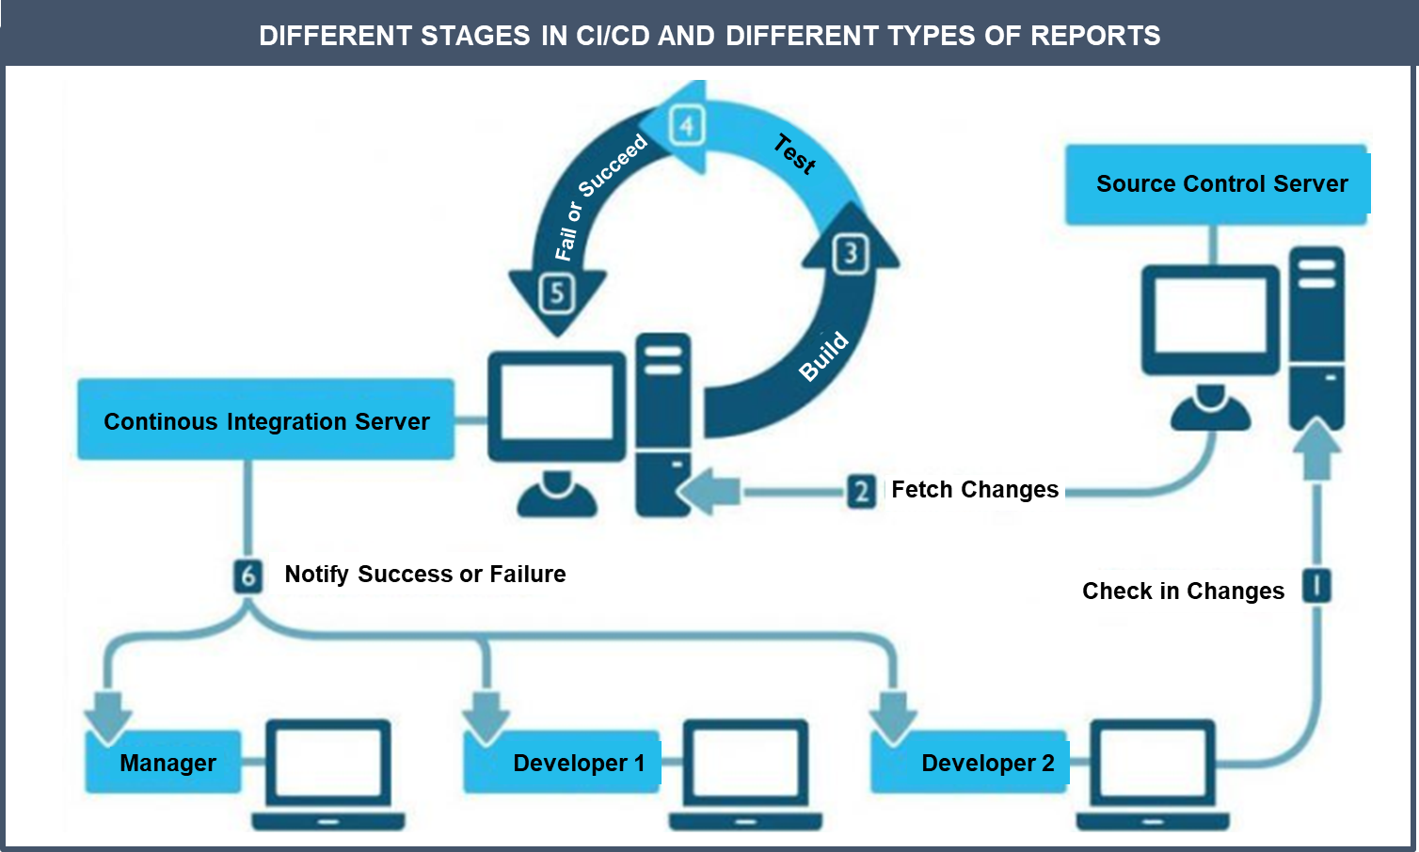
2.9 Publishing Report to Development Team
Notes:
Notes to the Facilitator:
Give the participants an overview about the reports published to development team.
Notes to the Participants:
Many reports are created as part of CI/CD process. Developers are interested in below reports:
Unit test reports
Static code analysis reports
Build status reports (Success/Failures)
Integration test reports
Deployment reports

Slide 40
What did You Grasp?
1. In which phase code is freezed?
After daily builds
Pre-deploy phase
After the release
Code is never freezed
Notes:
Notes to the Facilitator:
Answer:
1. B. Pre-Deploy phase
In Pre-deploy phase code is freezed and developers can not check-in the code. Only critical bug fixes can be committed.

Slide 41
What did You Grasp?
2. All builds are automatically deployed to:
Staging environment
Production environment
Testing environment
UAT environment
Notes:
Notes to the Facilitator:
Answer:
2. C. Testing environment
By default, all the builds are published to the developer’s environment (Test environment). Only qualified builds go to Staging and then UAT/Production.

Slide 42
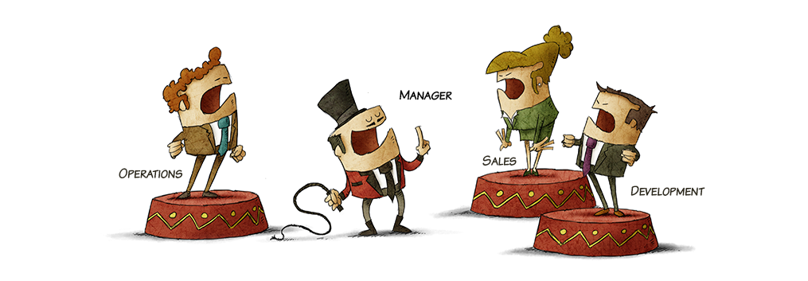
Group Discussion
Notes:
Notes to the Facilitator:
Form different groups of students. Each group should talk about the topics that is covered so far.
Notes to participants:
We have so far discussed about concept of VCS, merging local changes to the VCS tool, automated code builds, static code analysis, automated unit testing, code coverage analysis, automated packaging of the build artifact, Overview of provision and deploy to test environment, automated functional testing and publishing report to the development team.
In next slide let us discuss about Google Canary release strategy which is being used to release new features through Continuous delivery.

Slide 43
2.10 Google’s Continuous Delivery – Case Study
Secret to Google’s engineering release is Canary release.
A Canary release is releasing features only to some users.
If the features are not successful then they are quickly rolled back or fixed/removed.
Canary release is tested by close to 50000 employees.
The advantages of Google’s canary release approach are:
stability – there’s always a release to roll back to
feedback – real world users give real world reactions
Notes:
Notes to the Facilitator:
DIscuss about the Google’s Continuous delivery case study with the participants.
Notes to the Participants:
In previous slides, we have talked a lot about Continuous Integration / Continuous Delivery. Let's go through Google’s continuous delivery mechanism to understand how they are releasing new features successfully.
Google uses Canary release methodology to release new features.
From Monday throughout the week, Google gradually releases new features internally to its own users. Google monitors hundreds of different metrics on stability and scalability. Google’s employees act as canaries – immediately provide details about any issues that come up while testing. If any of the core metrics are impacted significantly, then the release is rolled back entirely. However, critical issues are fixed and the release goes to the entire Google employee base.
On the coming Monday, Google will take the canary release that is rolled out to Google employees externally. Google will start delivering the new release to more users. Google will continue to monitor the new feature for stability and scalability – external users are considered as the true “staging” environment. Google will then do a sentiment analysis for keywords like “Gmail Sucks” on twitter, etc. If there are spikes, Google will stop or roll back the new release.

Slide 44
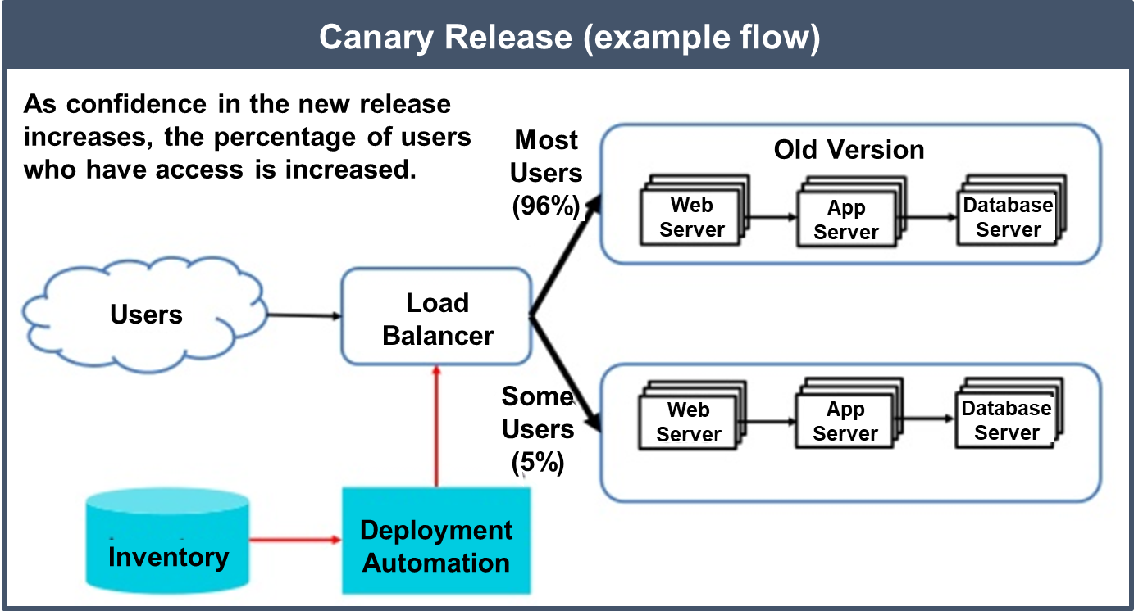
2.11 Google’s Continuous Delivery – Case Study (Contd.)
The following image explains Canary release model in detail.
Notes:
Notes to the Facilitator:
Explain the participants about the Google’s Canary release – Case study.
Notes to the Participants:
The above picture explains Canary release model in detail.
Deployment models like canary can prevent major production outages
Canary release helps the team to pinpoint deployment failures in the process and correct them
Pulling together a basic failure response plan

Slide 45
In a nutshell, we learnt:
1.2 a Core CI Process
Merging local changes to the integration branch of VCS tool
Automated code builds
Static code analysis
Automated unit testing
Code coverage analysis
Automated packaging of the build artifact
1.2 b Advanced CI Process
Provision and deploy to test environment
Automated functional testing
Publish report to the development team
Notes:
Notes to the Facilitator:
Share the module summary with the audience.
Ask the participants if they have any questions. They can ask their queries by raising their hands.
Notes to the Participants:
Now, you have reached the end of the module, In this module, you have learned:
1.2 a Core CI Process
Merging local changes to the integration branch of VCS tool
Automated code builds
Static code analysis
Automated unit testing
Code coverage analysis
Automated packaging of the build artifact
1.2 b Advanced CI Process
Provision and deploy to test environment
Automated functional testing
Publish report to the development team

Slide 46
Next Module 3:

